Slide 1
Azure Synapse + Spark: Twitter Eurovision Data
Anish Dixit
Akshit Miglani
Ameya Bhamre
Ananya Bajaj

Slide 2
Contents
Azure Synapse
Overview
Features
Sharding
Replication
Spark
Basic overview
Setup Spark cluster in Azure
Load Twitter data into Spark
Query Twitter data in Spark

Slide 3
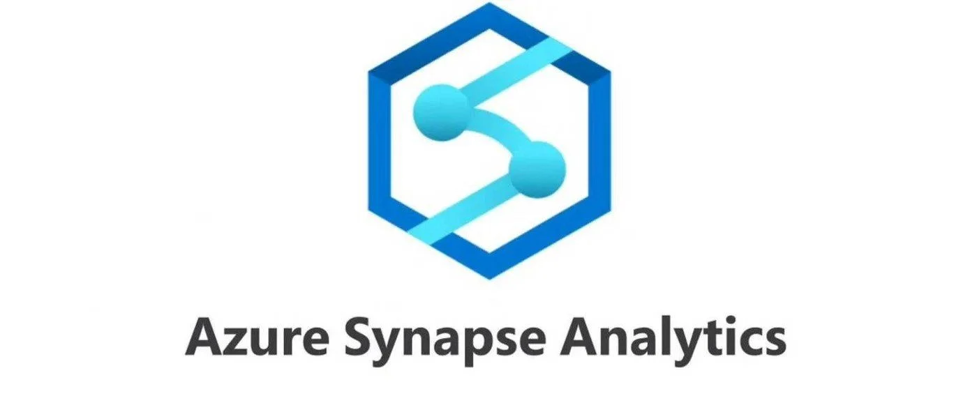

Slide 4
OVERVIEW
Azure Synapse Analytics is an enterprise analytics service that accelerates time to insight across data warehouses and big data systems.
It brings together the best of SQL technologies used in enterprise data warehousing, Apache Spark technologies for big data, and Azure Data Explorer for log and time series analytics.
Limitless scale to rapidly deliver insights from all your data across data warehouses and big data analytics systems
Powerful insights uncovered from all your data transformed with machine learning models to enhance your intelligent apps
Unified experience for developing end-to-end analytics solutions to significantly reduce project development time
The most advanced security and privacy features on the market, including column- and row-level security and dynamic data masking

Slide 5
FEATURES AND CAPABILITIES
FEATURE | DESCRIPTION
Apache Spark Delta Lake tables in serverless SQL pools | The ability to for serverless SQL pools to access Delta Lake tables created in Spark databases is in preview.
Apache Spark elastic pool storage | Azure Synapse Analytics Spark pools now support elastic pool storage in preview. Elastic pool storage allows the Spark engine to monitor worker node temporary storage and attach more disks if needed.
Apache Spark Optimized Write | Optimize Write is a Delta Lake on Azure Synapse feature reduces the number of files written by Apache Spark 3 (3.1 and 3.2) and aims to increase individual file size of the written data.
Apache Spark R language support | Built-in R support for Apache Spark is now in preview.
Azure Synapse Data Explorer | The Azure Synapse Data Explorer provides an interactive query experience to unlock insights from log and telemetry data. Connectors for Azure Data Explorer are available for Synapse Data Explorer.

Slide 6
FEATURES AND CAPABILITIES
FEATURE | DESCRIPTION
Browse ADLS Gen2 folders in the Azure Synapse Analytics workspace | You can now browse an Azure Data Lake Storage Gen2 (ADLS Gen2) container or folder in your Azure Synapse Analytics workspace in Synapse Studio.
Capture changed data from Cosmos DB analytical store | Azure Cosmos DB analytical store now supports change data capture (CDC) for Azure Cosmos DB API for NoSQL and Azure Cosmos DB API for MongoDB.
Data flow improvements to Data Preview
Distribution Advisor | The Distribution Advisor is a new preview feature in Azure Synapse dedicated SQL pools Gen2 that analyzes queries and recommends the best distribution strategies for tables to improve query performance.
Distributed Deep Neural Network Training | Learn more about new distributed training libraries like Horovod, Petastorm, TensorFlow, and PyTorch in Deep learning tutorials.

Slide 7
REPLICATION
Replication refers to the process of creating and maintaining duplicate copies of data for high availability and disaster recovery purposes.
Ensures data redundancy, fault tolerance, and continuous access to critical data.
Available replication options in Azure Synapse Analytics:
Cross-region replication: Replicate data across different Azure regions for geographic redundancy and disaster recovery.
Geo-redundant storage: Store multiple copies of data in different Azure data centers within the same region for high availability.
Azure Blob Storage: Utilize Azure Blob Storage for storing replicated data.
Benefits of replication:
High availability: Ensure continuous access to data even in the event of a localized outage or failure.
Disaster recovery: Facilitate quick recovery and restoration of data in case of a major system failure or disaster.
Reduced latency: Improve data access performance by replicating data closer to the end-users or applications.

Slide 8
REPLICATION
Process of replication:
Data synchronization: Initially replicate the data from the primary source to the replica location.
Incremental updates: Continuously replicate incremental changes or updates to keep the replica in sync with the primary data source.
Monitoring and validation: Monitor the replication process and validate data consistency and integrity between the primary and replica locations.
Best practices for implementing replication:
Regular testing: Perform regular testing and validation of the replicated data to ensure its accuracy and integrity.
Monitoring and alerts: Set up monitoring and alerts to proactively identify any replication issues or failures.
Documentation: Document the replication setup, configuration, and procedures for future reference and troubleshooting.

Slide 9
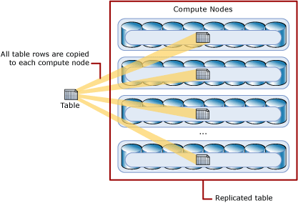

Slide 10
SHARDING
Sharding is a technique used to distribute data across multiple nodes for improved query performance and scalability.
Helps in handling large data volumes and achieving parallel processing capabilities.
Sharding strategy employed in Azure Synapse Analytics:
Distribution keys: Determine how data is distributed across the nodes.
Hash-based distribution: To evenly distribute data across nodes.
Data partitioning: Data is divided into logical partitions based on the distribution key.
Even distribution: Evenly distribute data across the nodes to ensure balanced query execution and optimal performance.
Data movement: Occurs transparently across nodes as data is added or modified.

Slide 11
SHARDING
Benefits of Sharding
Scalability: Allows for horizontal scalability by distributing data across additional nodes as the workload increases.
Performance: Improves query performance by enabling parallel processing and reducing data retrieval times.
Fault tolerance: Enhances fault tolerance, as the loss of a single node does not result in the loss of the entire dataset.
Distribution key selection: Choosing an appropriate distribution key to ensure even data distribution and balanced query execution.
Data skew: When some distribution keys have more data than others, can impact performance. Consider strategies to mitigate data skew, such as range partitioning or composite distribution keys.

Slide 12
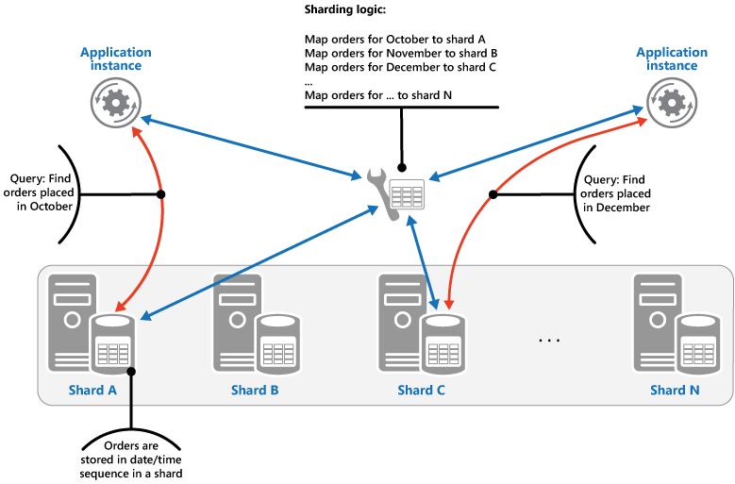

Slide 13
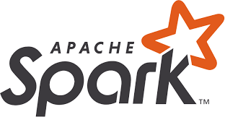

Slide 14
INTRODUCTION
Apache Spark is a distributed computing system designed to handle big data processing and analytics. It is an open-source project and is built for speed, ease of use, and flexibility
Spark was initially developed at UC Berkeley's AMPLab in 2009 and was later open-sourced in 2010. Since then, it has become one of the most popular big data processing frameworks
Spark is designed to be used in a distributed computing environment, which means it can handle large amounts of data by breaking it into smaller chunks and processing them in parallel across multiple nodes

Slide 15
ARCHITECTURE
Spark follows a master-worker architecture where the master node manages the distribution of tasks across the worker nodes
The master node is responsible for coordinating the execution of Spark applications and scheduling tasks on worker nodes
Worker nodes run the tasks and return the results to the master node. Spark provides a variety of cluster managers, including Apache Mesos, Hadoop YARN, and Spark Standalone

Slide 16
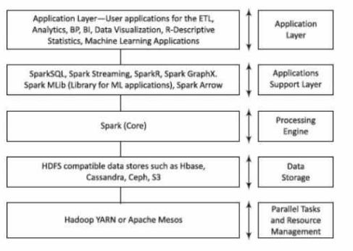
A sample five-layer architecture for running applications using Spark stack

Slide 17
SPARK STACK - Application Support Layer
Spark SQL
Spark Streaming
SparkR
Spark MLib
Spark GraphX
Spark Arrow
Notes:
Spark Arrow: columnar in memory analytics
SparkR: the user can interactively run R jobs from a shell on a cluster
Spark Streaming: real-time streaming data
Spark Mlib - scalable ML library

Slide 18
KEY FEATURES
In-memory processing: Spark can store data in memory, which allows for faster access and processing of large datasets
Data processing APIs: Spark provides a wide range of APIs for processing data, including SQL, streaming, machine learning, and graph processing
Fault tolerance: Spark can recover from node failures and data loss by re-executing failed tasks on other nodes or replicating data
Compatibility: Spark supports a variety of data sources and storage systems, including Hadoop Distributed File System (HDFS), Apache Cassandra, and Amazon S3

Slide 19
USE CASES
Batch processing: Spark is commonly used for processing large datasets in batch mode, such as running ETL pipelines or generating reports
Real-time processing: Spark Streaming provides an API for processing data in real-time, such as processing data from social media feeds or monitoring system logs
Machine learning: Spark ML provides an API for training and deploying machine learning models at scale, such as predicting customer churn or detecting fraud
Graph processing: Spark GraphX provides an API for processing large-scale graphs, such as analyzing social networks or identifying relationships in a supply chain

Slide 20
Setup Spark cluster in Azure
Introduction:
Azure Synapse is a cloud-based analytics service that provides a single platform for big data processing. It enables us to run Apache Spark workloads to process and analyze large datasets. Azure Synapse provides an End-to-end Analytics Solution by blending Big Data Analytics, Data Lake, Data Warehousing, and Data Integration into a single unified platform. It has the ability to query relational and non-relational data at a petabyte-scale by running intelligent distributed queries among nodes at the backend in a fault-tolerant manner. In this presentation, we will walk through the steps to set up Spark using Azure Synapse.

Slide 21
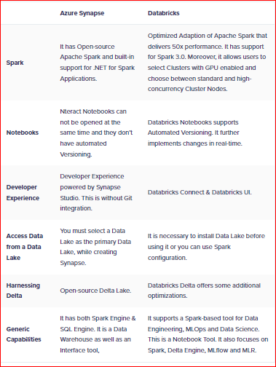
Setup Spark cluster in Azure
Platform Comparison: Considering a unified analytics platform, scalability and performance for our use case, Data Integration, cost optimization: workload isolation, allowing us to allocate resources based on workload priority, ensuring efficient resource utilization and cost control and having no urgent need of MLOps and Machine learning, we went ahead with Azure Synapse Analytics

Slide 22
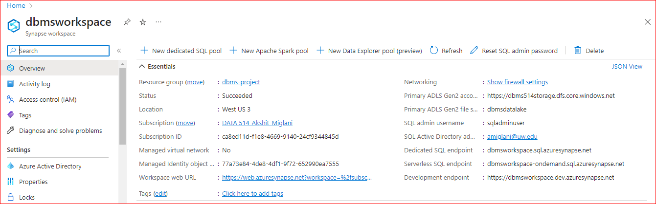
Setup Spark cluster in Azure
Step 1: Create an Azure Synapse workspace
The first step is to create an Azure Synapse workspace in the Azure portal. This workspace is a unified workspace that allows us to manage our big data processing and analytics tasks. A Synapse workspace is a securable collaboration boundary for doing cloud-based enterprise analytics in Azure. A workspace is deployed in a specific region(in our case West) and has an associated ADLS Gen2 account and file system (for storing data). A workspace is under a resource group. A workspace allows us to perform analytics with SQL and Apache spark. Resources available for SQL and Spark analytics are organized into SQL and Spark pools. We also have Linked services to allow external data access: A workspace can contain any number of Linked service, essentially connection strings that define the connection information needed for the workspace to connect to external resources.

Slide 23
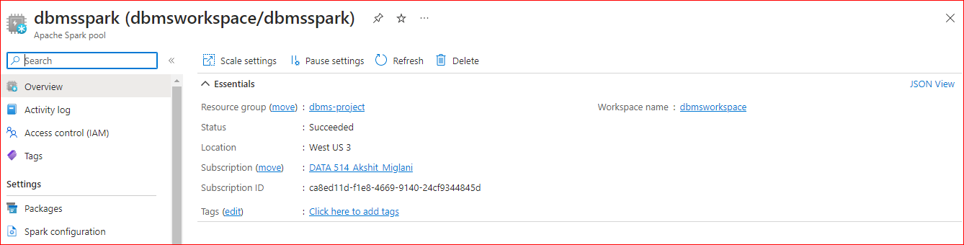
Setup Spark cluster in Azure
Step 2: Create a Spark pool
Once our workspace is created, we created a Spark pool. A Spark pool is a set of resources that we can use to run Spark jobs. It is a set of metadata that defines the compute resource requirements and associated behavior characteristics when a Spark instance is instantiated. These characteristics include but aren't limited to name, number of nodes, node size, scaling behavior, and time to live.

Slide 24
Setup Spark cluster in Azure
Node Setup
Nodes: Apache Spark pool instance consists of one head node and two or more worker nodes with a minimum of three nodes in a Spark instance. The head node runs extra management services such as Livy, Yarn Resource Manager, Zookeeper, and the Spark driver. All nodes run services such as Node Agent and Yarn Node Manager. All worker nodes run the Spark Executor service.
Node Sizes: A Spark pool can be defined with node sizes that range from a Small compute node with 4 vCore and 32 GB of memory up to a XXLarge compute node with 64 vCore and 512 GB of memory per node. Node sizes can be altered after pool creation although the instance may need to be restarted.
Autoscale: Autoscale for Apache Spark pools allows automatic scale up and down of compute resources based on the amount of activity. When the autoscale feature is enabled, we set the minimum, and maximum number of nodes to scale(we did 3 - 16). When the autoscale feature is disabled, the number of nodes set will remain fixed.

Slide 25
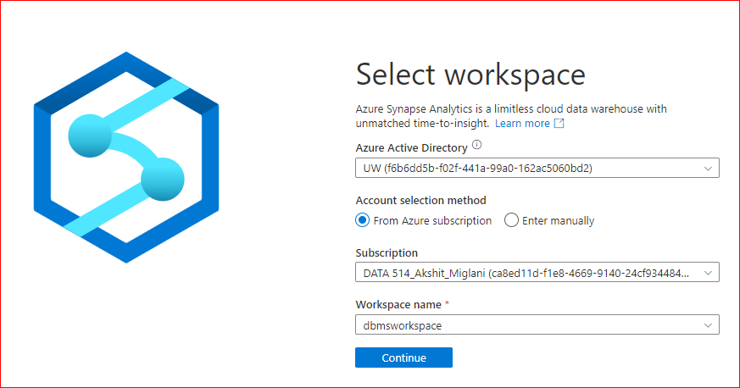
Setup Spark cluster in Azure
Step 3: Storage Account and Connecting Azure Resources to Synapse
To analyze data using Spark, we created a storage account. On a storage account, we can upload data from a variety of sources, such as Azure Blob Storage, Azure Data Lake Storage, or on-premises data sources. Once we uploaded the data, we used it in our Spark jobs by connecting the Azure workspace to Synapse Analytics platform. We’re running our data system on two pillars: Azure resources such as workspace, data storage and Synapse Analytics platform. To leverage the capabilities of Synapse analytics platform by spinning up a spark pool using a notebook, we need the Azure resources on demand in the workspace interface. We do that by connecting the entire workspace to Synapse Analytics.

Slide 26
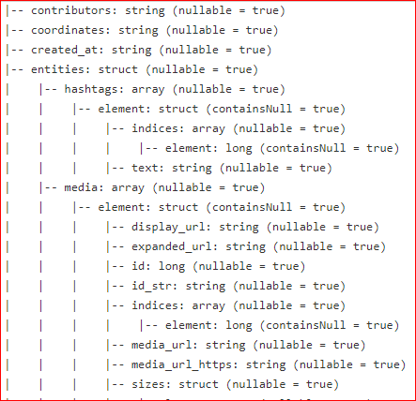
Load Twitter data into Spark
Step 1: Our data is a nested JSON which we will need to convert to CSV in order to create Spark DataFrame easily.. JSON is a popular data format used for exchanging information between systems. It organizes data in a hierarchical structure, making it suitable for representing complex objects. Nested JSON structures contain objects or arrays within other objects or arrays, posing a challenge when working with such data in Spark.

Slide 27
Load Twitter data into Spark
Step 2: Convert nested JSON to Spark DataFrame using Python Pre-Processing
Parsing the Nested JSON: To work with the nested JSON data, we use the from_json function. This function parses the JSON column and converts it into a struct type, preserving the nested structure. We specify the schema of the JSON data to ensure correct parsing.
Exploding Arrays: If the JSON contains arrays, we might need to expand them to process individual elements. Spark's explode function allows us to unnest arrays, creating multiple rows for each array element. This step helps to flatten the nested structure and enables easy access to individual array elements.
Extracting Nested Fields: Once the JSON data is parsed and arrays are exploded, we can access nested fields using dot notation. By specifying the path to the desired field, we can extract and create new columns for further analysis or transformations.
Performing Operations: With the flattened DataFrame, we can perform various operations like filtering, aggregating, or joining with other data sources. Spark provides a rich set of functions and SQL-like expressions to manipulate and transform the data efficiently.

Slide 28
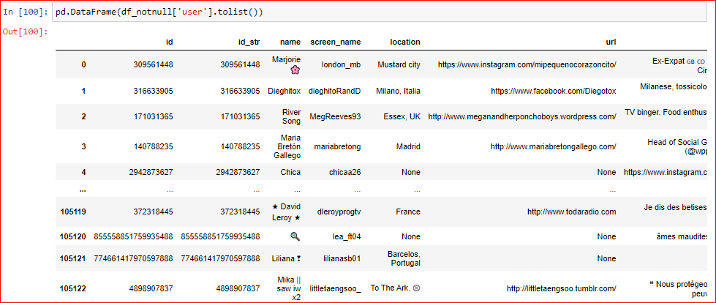
Load Twitter data into Spark
Result: We get a flattened DataFrame considering unique values per row for columns of interest. We can use the SQL expression in the spark notebook to do the analysis

Slide 29
Thank You!
Any Questions?

